Slide 1
About Johan Vasara Sátnejođiheaddji / Ordfører / Mayor

Slide 2
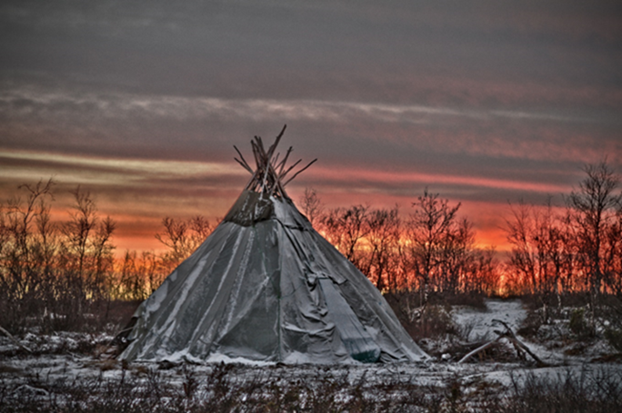
The symbols of Guovdageaidnu
Notes:
Guovdageaidnu is the strongest Sami community in the world. The sami language, sami reindeer herding and the sami culture are stronger here, then anywhere else. This is symbolized by our logo, which has a sami lavvo or tipi in it.

Slide 3
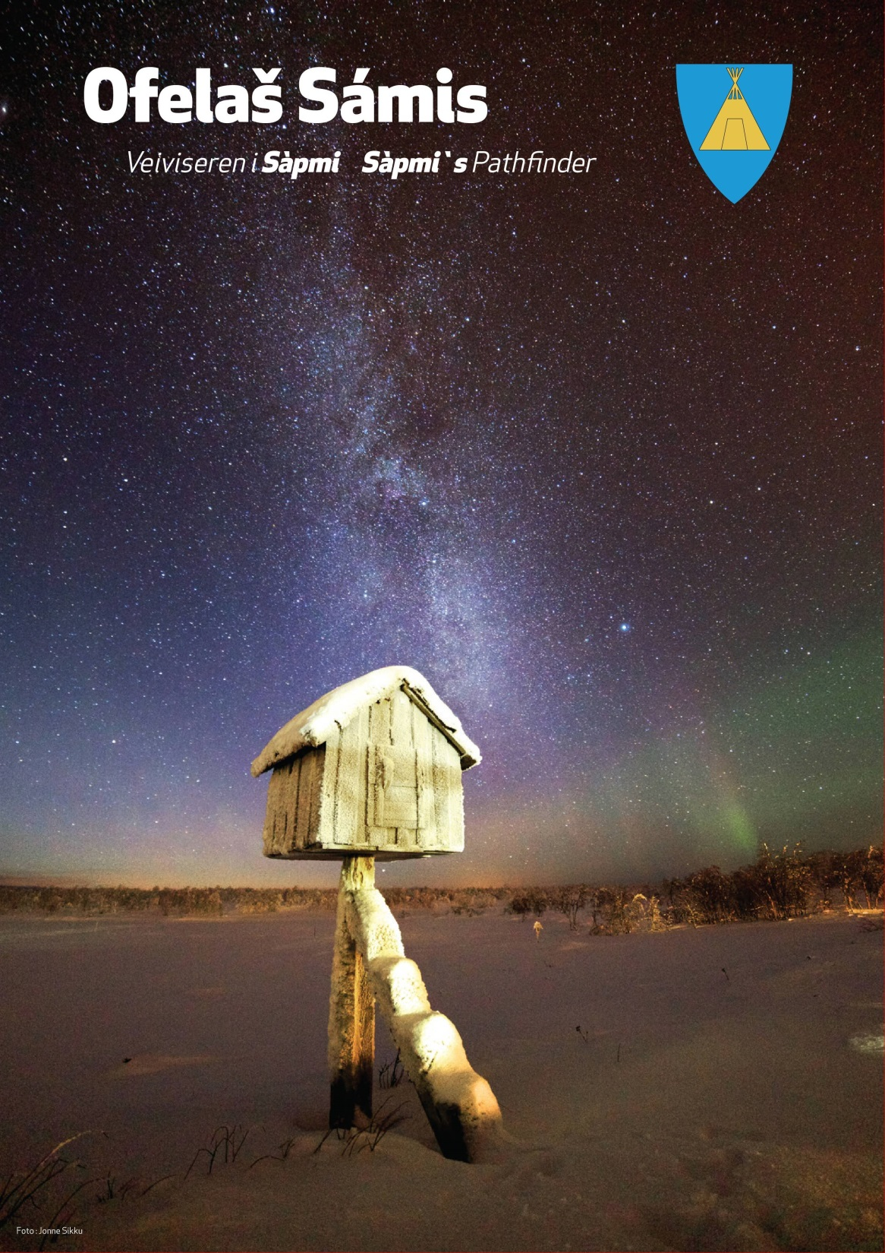
Påsken
Viktig høytid
Store familiebegivenheter
Største kulturmønstringen

Slide 4
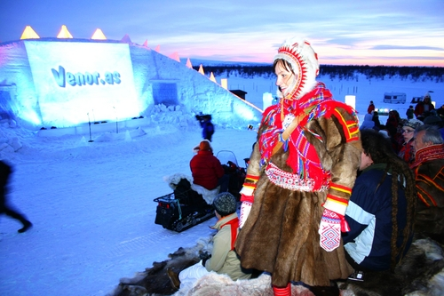
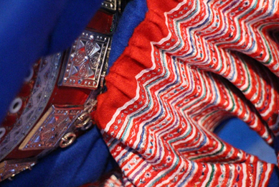
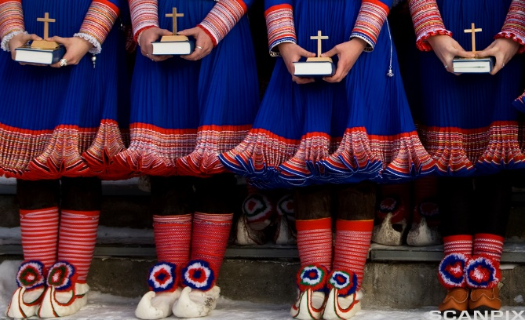
Notes:
Other cultural artifacts of Guovdageaidnu are our traditional sami costumes, which tell other samis that we are from Guovdageaidnu, but also reindeer are an important symbol of Guovdageaidnu. In the middle of this picture you can see the logo of our local sports team.

Slide 7
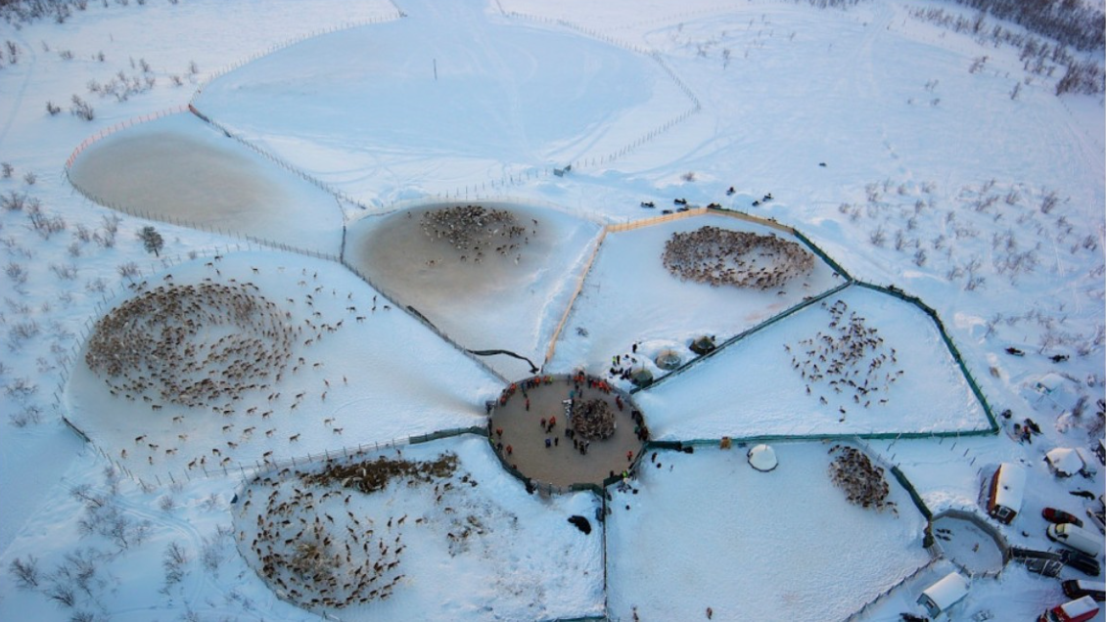
About Guovdageaidnu
Guovdageainnu suohkan – Kautokeino kommune
10.000 km2
3.000 inhabitants
95% speak Northern Sami
100.000 reindeer
Sami majority population
Cultural Capital of Sápmi
Notes:
You may already know this about Guovdageaidnu and that there is no such thing as Sápmi without Guovdageaidnu, we think.

Slide 8
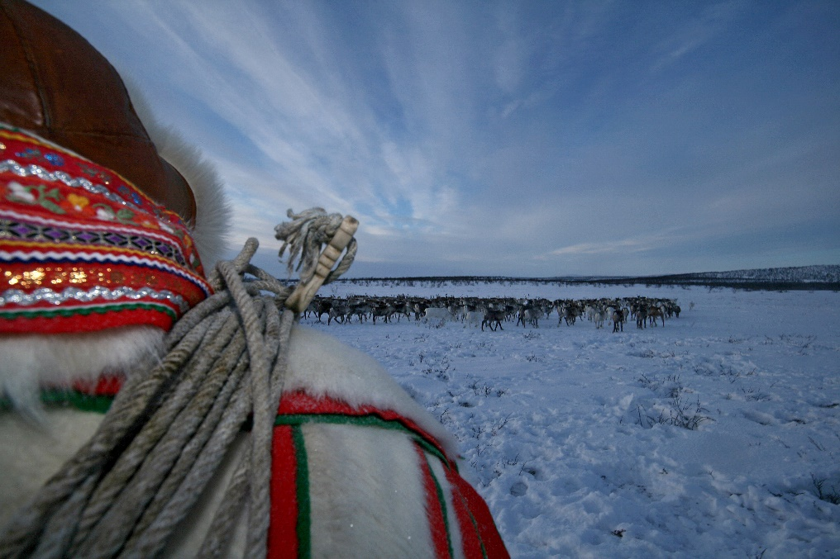
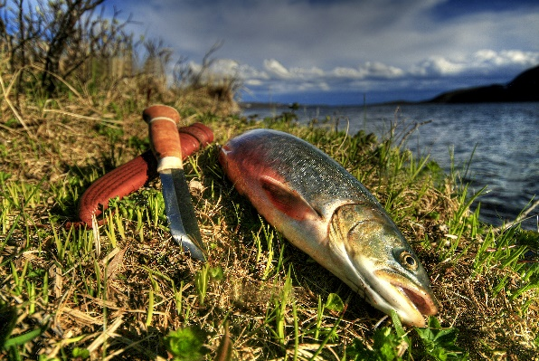
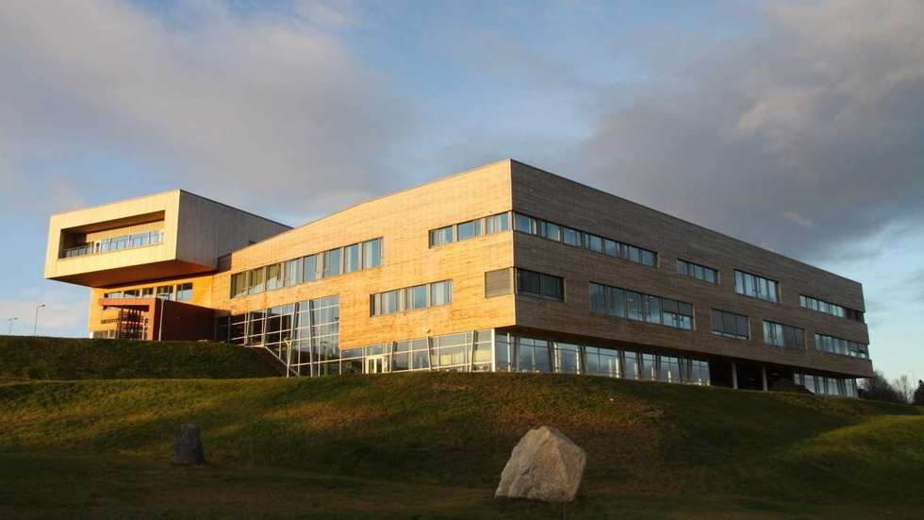
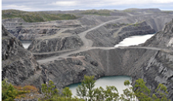
Employment
Reindeer herding
Tourism
Service
Public Service/private sector: 50/50
Notes:
The public sector is the most important employer in this region, followed by reindeer herding. Mining companies are also trying to get access to Guovdageaidnu on a large scale, which is a large political issue here, because it is in conflict with reindeer herding.

Slide 9
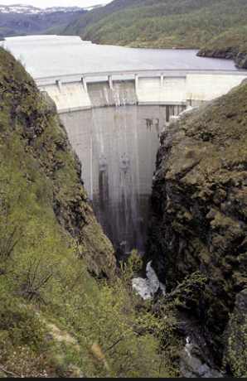
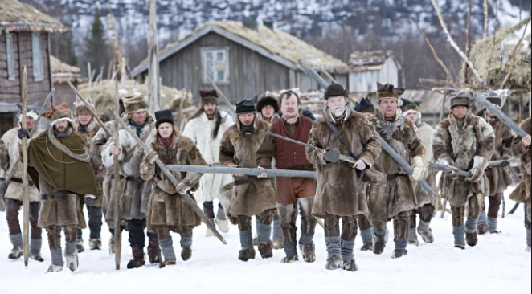
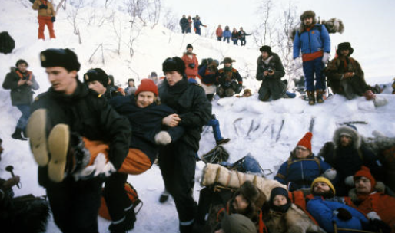
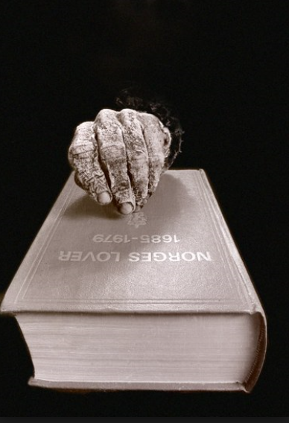
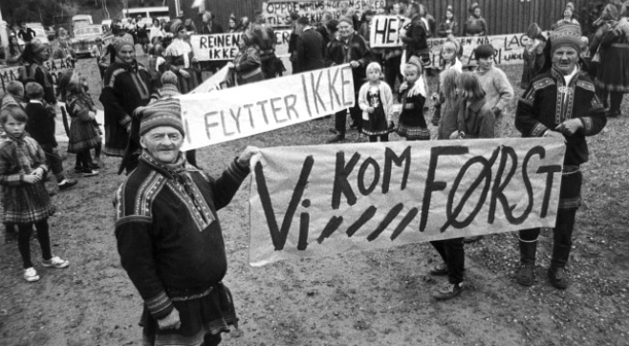
Historical events and a few fun-facts
«The Cabin-Church» of 1650
Established by the Swedish Crown
Oldest standing building in Finnmark
Local timber (!)
The Kautokeino Rebellion of 1852
The damming of the
Alta-Kautokeino River in 1979
Worlds northernmost spruce-
forest
Notes:
These are the most important historical events in Guovdageaidnu.

Slide 10
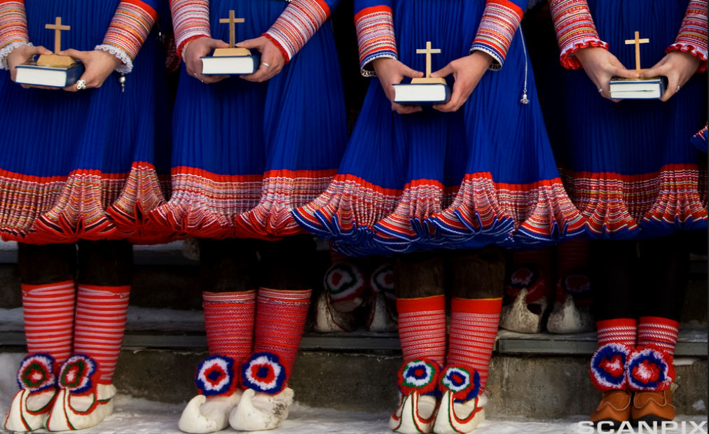
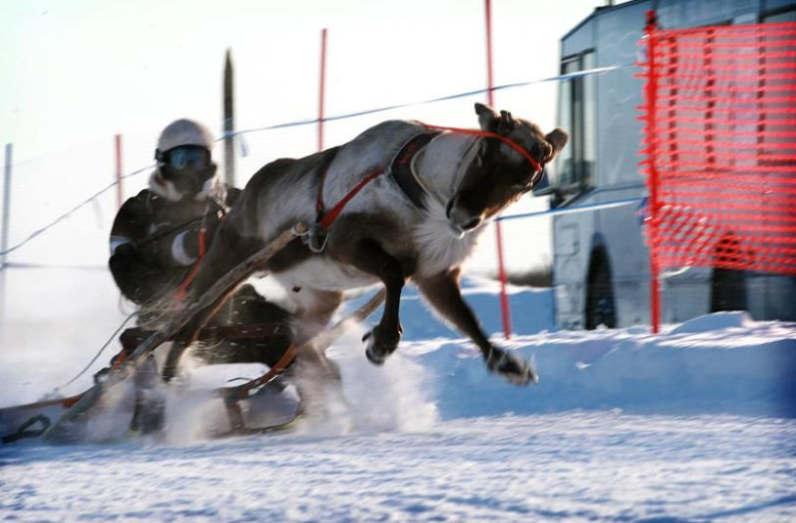
Current events
The Sami Easter Festival
Confirmation
Weddings with 3.000 guests
The Sami skirace
Snowmobile Dragrace on water
Reindeer races at winter
Resourceful for the New Region of
Troms & Finnmark?
Notes:
And these are the most important current events.

Slide 11
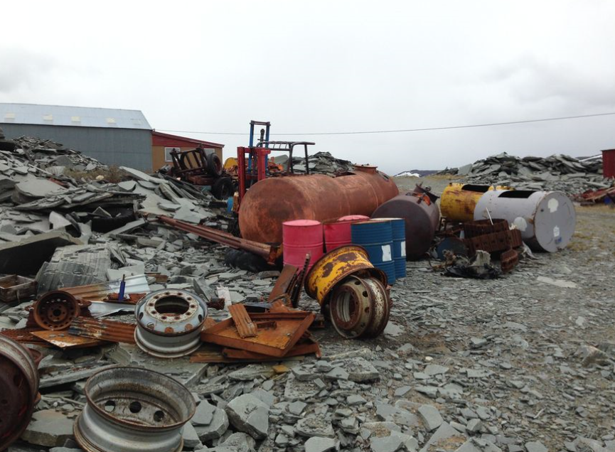
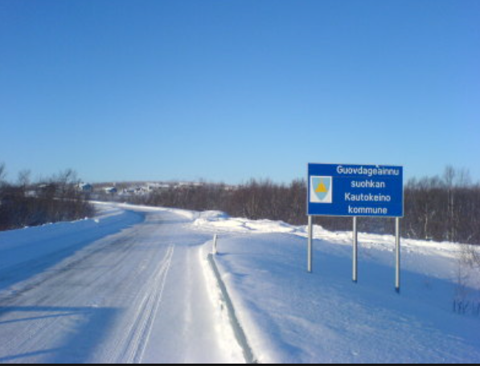
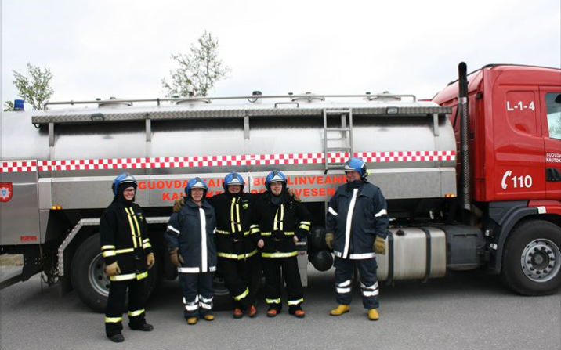
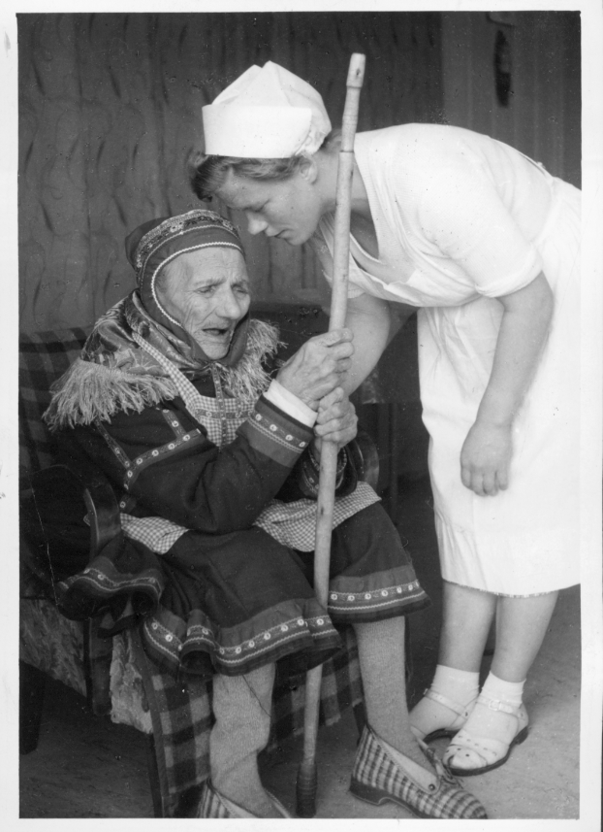
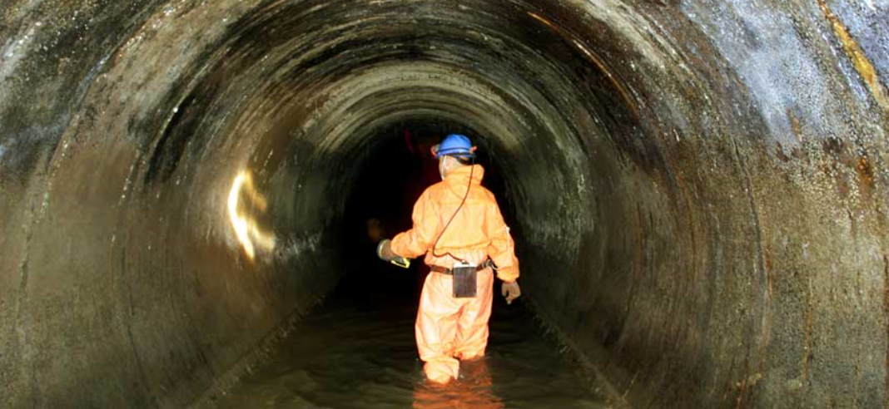
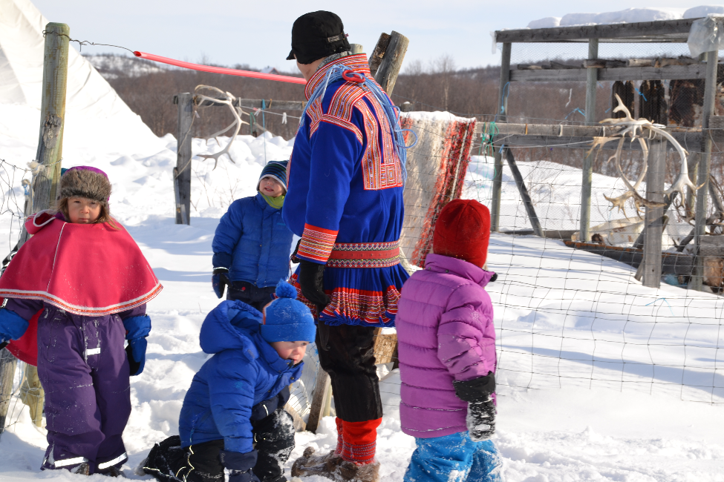
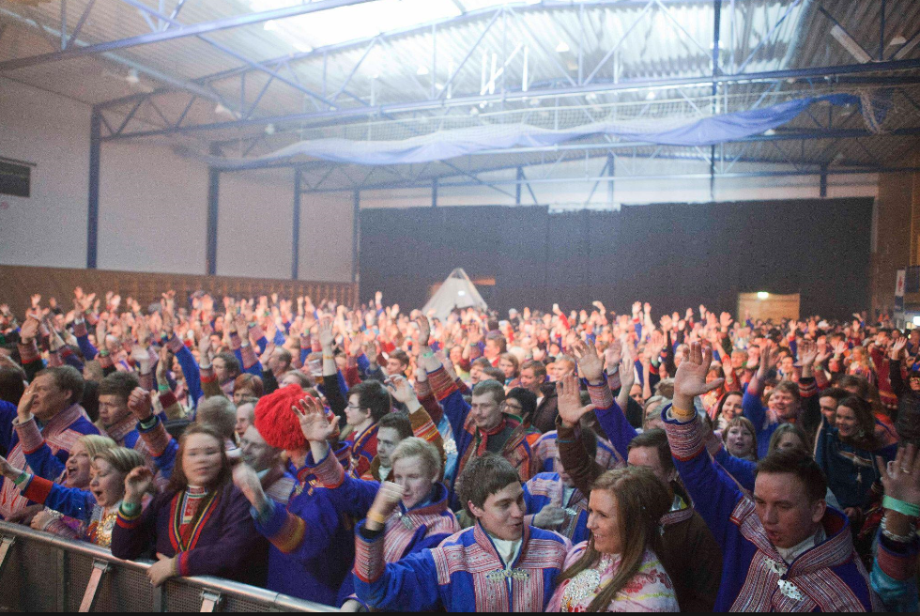
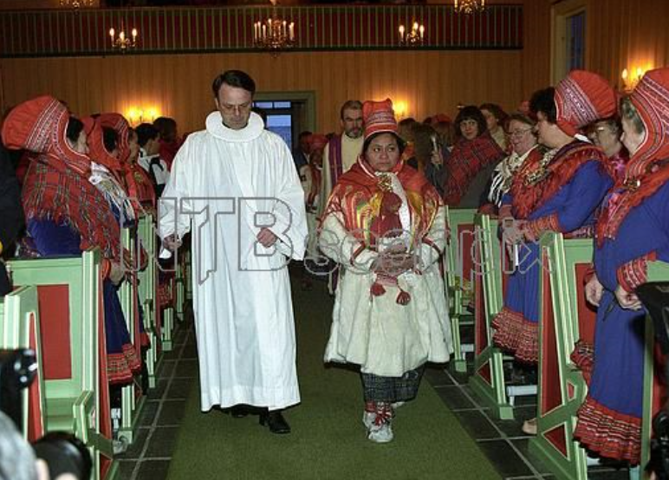
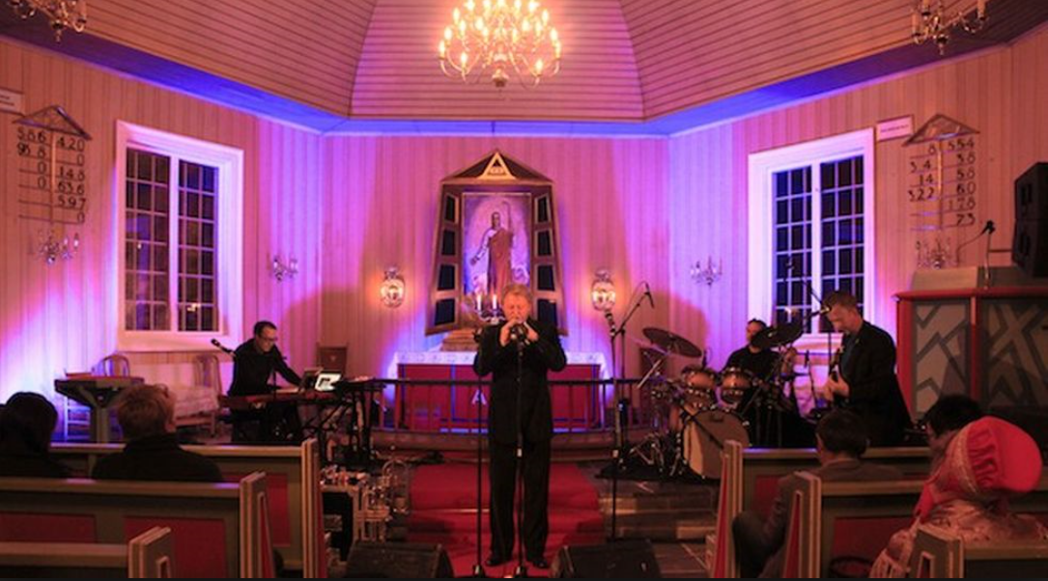
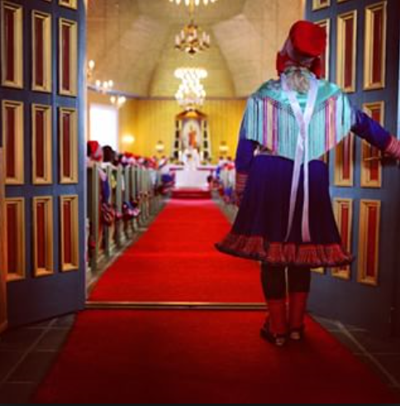
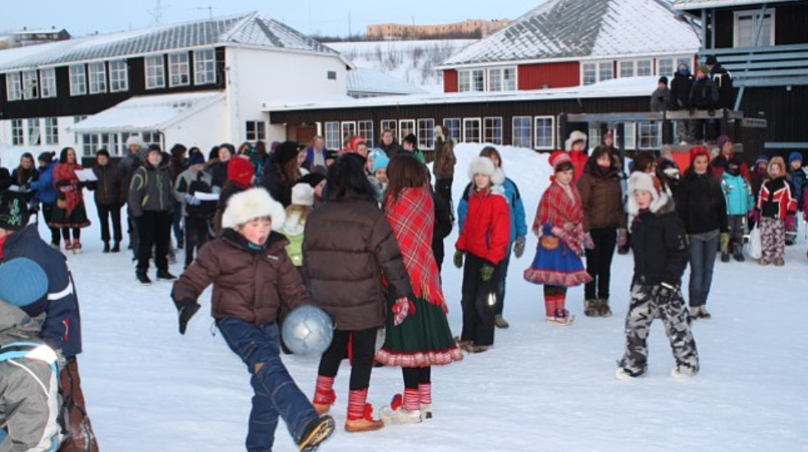
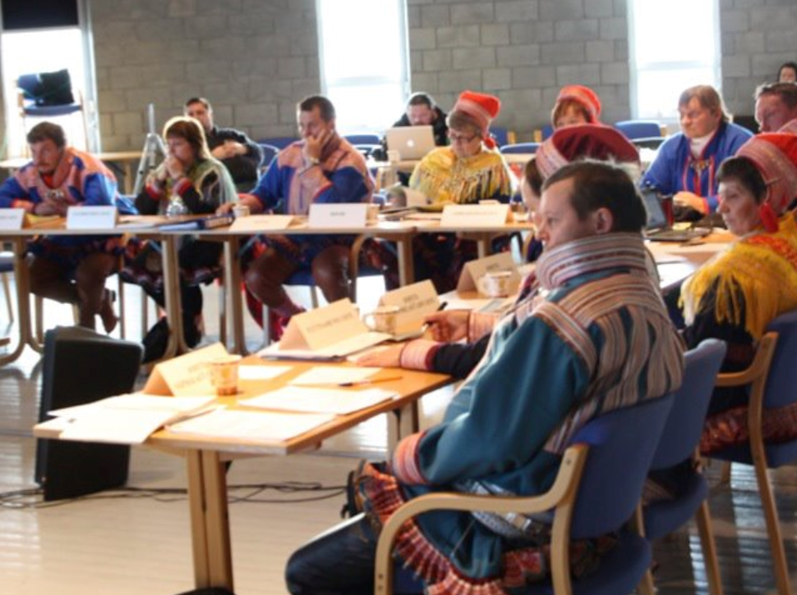
The main service provider in the municipality
Healtcare
Schools
Kindergartens
Water and sevage
Child welfare
Social benefit
Trash/sanitation
Retirement homes
Cultural services
Sporting facilities
Roads
Buildings
Plots
Fire service
Local Democracy
Notes:
«Guovdageainnu suohkan» – the municipality – is the most important organization in every city in Norway, because it provides most of the most important services. Here you see some of the services we provide.

Slide 12
From birth to adulthood
Third highest (!) birth rates of Finnmark
Only full Sámi-speaking child service in Norway
Only full Sámi-speaking enviroment for social services
Infant and school healthcare services - Sámi
150 children in 6 kindergardens – all of them Sámi
350 children in 2 schools – Sámi language as mother tongue
One high school and one University college
A municipality like any other – but unique in preservering and promoting Sámi language and culture
Resourceful for the New Region of Troms & Finnmark?

Slide 13
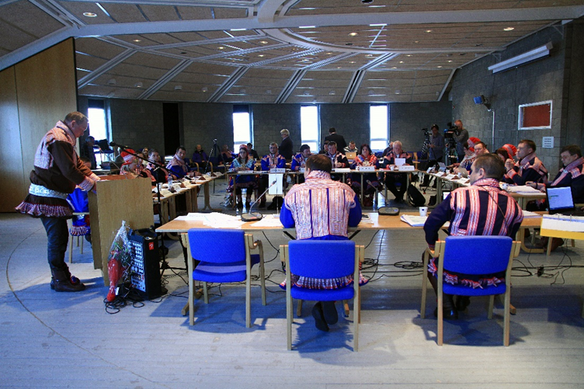
Political organization
Notes:
This is a politically lead organization in principle. The 19 members of the elected council gather 4 times a year and make political decions based on suggestions made by the administration throught the precidency. All but one of the 19 members of the elected council speak sami at the meetings.

Slide 14
The elected council - The only truly Sámi self-governing body
Notes:
This is a picture of the elected council. All – but one – are sami. These people represent both Norwegian parties and local lists. Our mayor represent the Norwegian labour party. We often feel pretty alone defending the sami in the Norwegian system: It`s just us and Karasjok and of course the Sami parliament.

Slide 15
Most of our employees speak Sámi
Good services in a Sámi speaking community = services in Sámi
90-95% our employes speak Sámi, but many prefer Norwegian in writing.
Notes:
The main language in Guovdageaidnu is Sami. This also applies to the municipality. But many of our employees do not write Sami very well. That has both historical reasons and is caused by the fact that there aren`t many areas in society where you can use Sámi, which ultimately means that you will loose the ability to write, even if you have learned the language at school. On the other hand: Institutions like ours can provide an arena where people can use Sámi in writing.

Slide 16
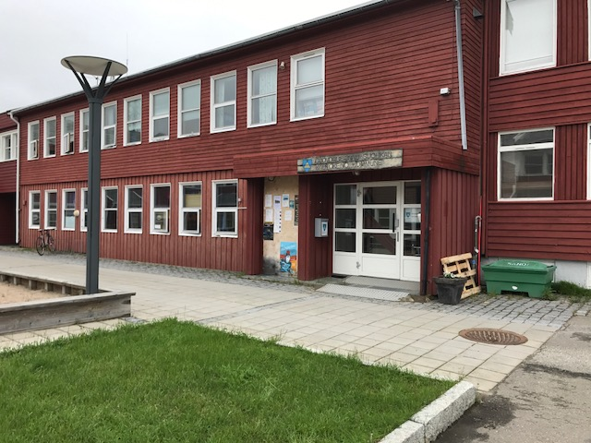
«Guovdageainnu suohkan» in numbers
Budget: Around NOK 300 mill.
Staff: Around 300 employees
Notes:
My main job is to make our 300 employees provide the best possible services – with the money we have – to the people who live here. My job is also to ensure that the decions made by the politicians are implemented.

Slide 17
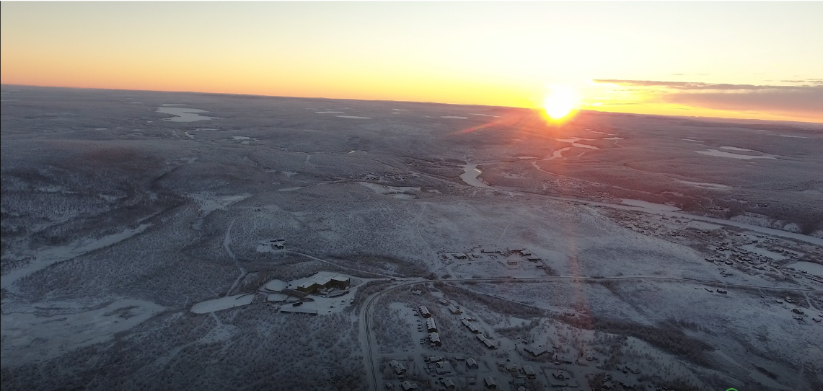
Threats and opportunities
Threats:
Reindeer herders have to leave the industry due to loss of pastures
The Sámi language and culture is threatened also in Guovdageaidnu
Centralization and budget cuts
Opportunities:
Responsible tourism – green, native, educative
The real Sami experience
Sámi language: We have the strongest sámi speaking community
The Cultural Capitol of Sápmi
Challanges:
Infrastructure, investors, lack of local initiatives
How can the New Region provide preservation – but still support and development?
Notes:
These are our threats and opportunities, I think. The problem part is the main area where we can learn from you, I think, because you have solved these problems already. Do you have any questions?

Slide 18
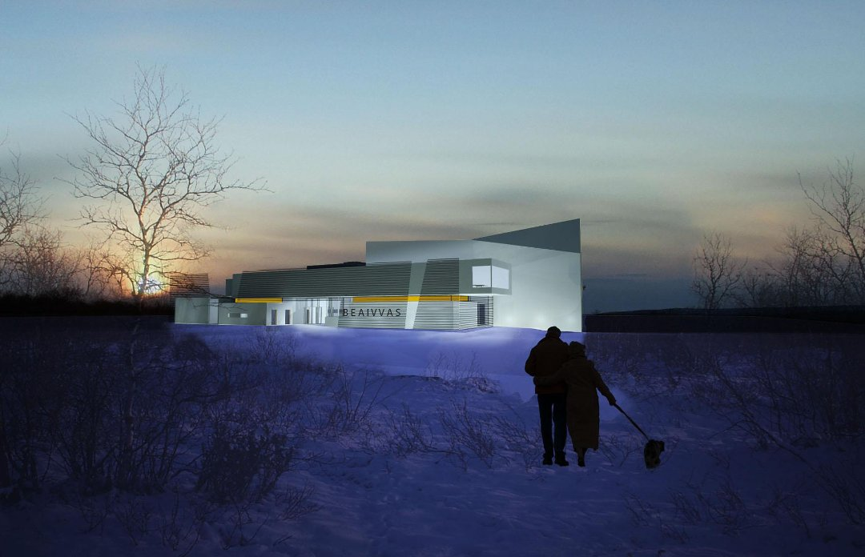
Geaidnu viidáseappot – The future

Slide 19
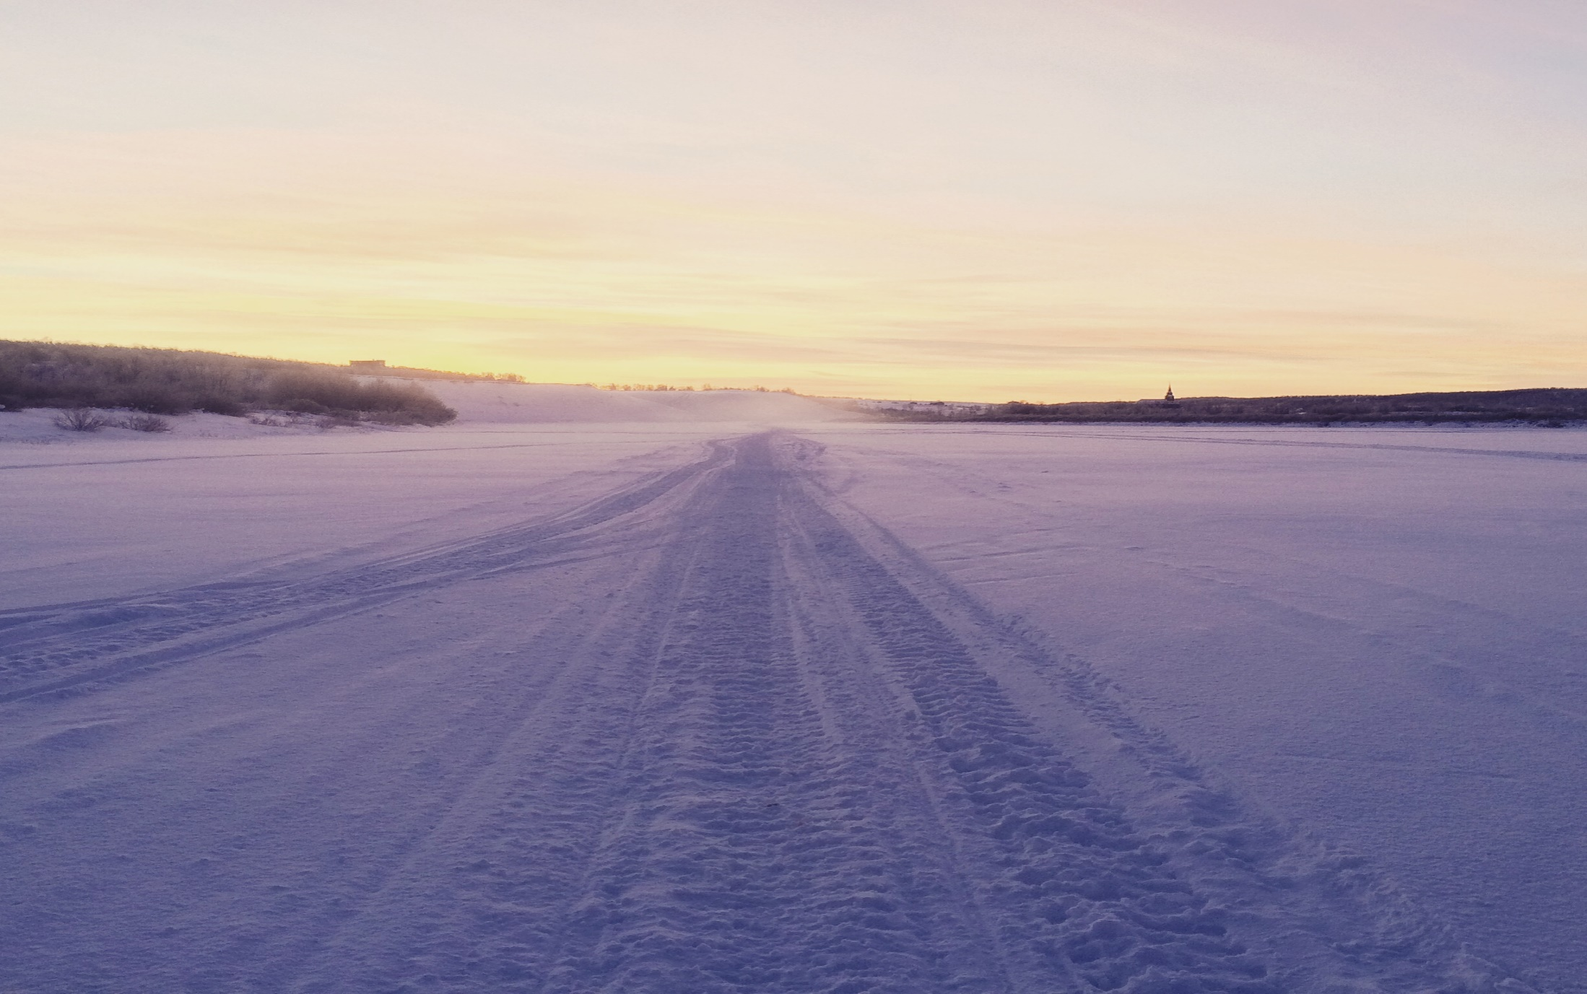
Guovdageainnu suohkan
Kautokeino kommune
Giitu – Thank you

